Slide 1

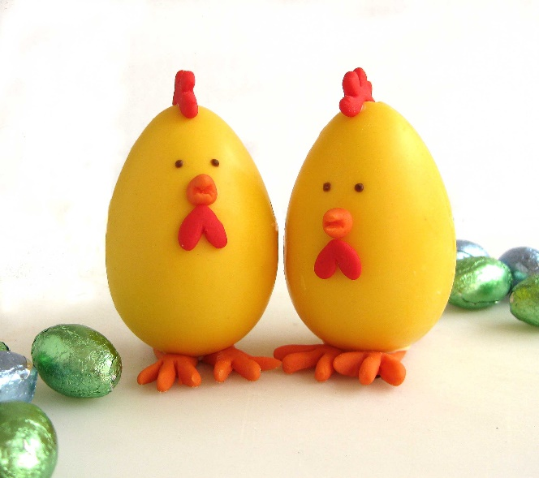

Super Eggs Trading
公司编号
Home
About us
Our Product
Contact us
We provide variety of egg based products
We manufacture and package eggs based product in a liquid form for the convenience of our customers. However, brown eggs (which is in a shell form) are sold too. There are many other products which is high quality and fresh are sold by us as well (salted egg, egg yolk, egg white), which you can check it up in the “our product” column.
Bottom part

Slide 2
*Bottom part
Address
No 6, Jalan 3 Pandan Indah Industrial Park
55100 Kuala Lumpur
Contact us
Tel：017-244 6448 (Ms Wai Whai Yee)
019-316 2070 (Mr Yap Kim Onn)
018-918 4405 (Mr Yap Zhen Hoe)
Fax: 03-4295 5762
Email
supereggs2007@gmail.com

Slide 3
Super Eggs Trading
公司编号
Home
About us
Our Product
Contact us
About US
Our company has been operated since year 2007. Throughout the years, there were many challenges and hardships that encountered by our company. However, our founder keep holding his principle which is provide high quality and hygiene products to his customers no matter how bad is the market. It is because our founder believes that being a trustworthy businessman is important than merely pursuing for profit.
As a food manufacturer, we must also ensure that our hygienic condition is meet with the authorities’ requirements, that’s the reason why we apply for the Halal certification. We can ensure that our products are safe to consume by following the SOP which is set by the authorities. And fortunately, our application has been approved.
We are dedicated to serve our customers with high quality egg-based products. We keep improving ourselves such as increase our efficiency and also seeking for better business collaboration. Feel free to contact us in the contact page if you wish to do so.

